Slide 1
Exploring Waterloo’s Teaching Culture: What instructors, staff, and students don’t know
Kristin M. Brown, PhD¹; Donna E. Ellis, PhD¹; Ken N. Meadows, PhD²
University of Waterloo Teaching and Learning Conference 2019
May 2, 2019
¹University of Waterloo Centre for Teaching Excellence; ²Western University Centre for Teaching and Learning

Slide 2
Today’s Session
What are the Institutional Teaching Culture Perception Surveys?
Why are “don’t know” responses important to reflect on?
What gaps are problematic and why might these gaps matter?
What can we do to address these gaps?

Slide 3
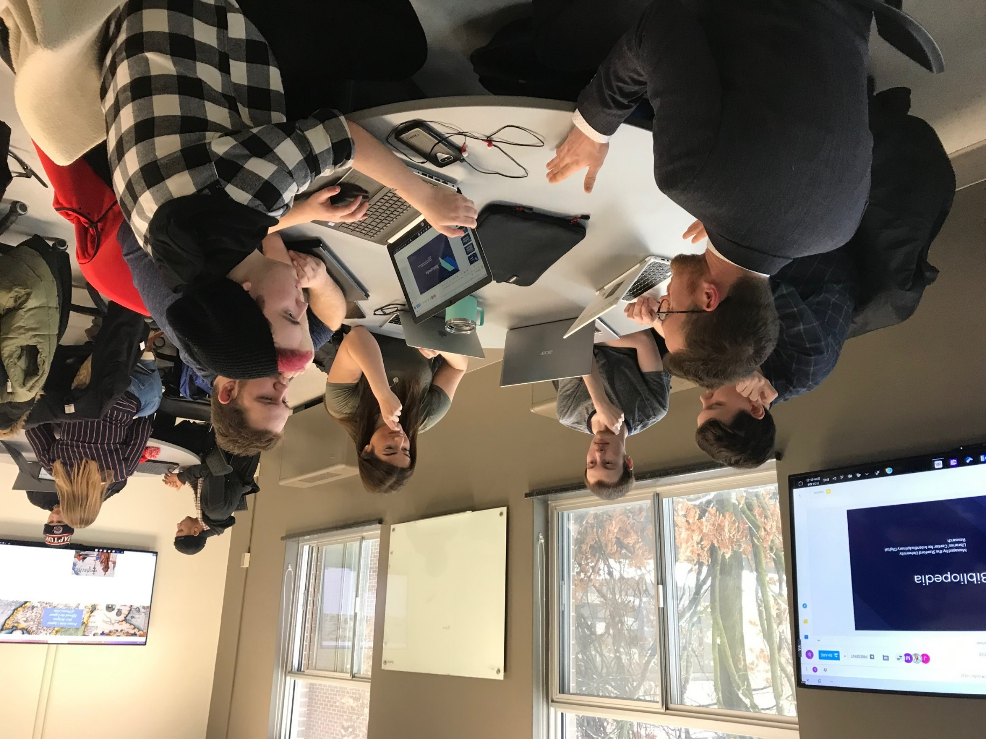

What is Teaching Culture?
Embedded behaviours, values, and beliefs of an institution¹
Can positively influence students’ learning, engagement, and persistence^{2,3,4}

Slide 4









Institutional Teaching Culture Perception Surveys (ITCPS)
Surveys developed from framework of institutional indicators that support quality teaching⁵
Ultimately intended to assess perceptions of institutional teaching culture over time for different stakeholder groups

Slide 5
ITCPS Levers
1
Institutional, strategic initiatives & practices prioritize effective teaching
2
Assessment of teaching is constructive & flexible
3
Effective teaching is implemented
4
5
Infrastructure exists to support teaching
6
Broad engagement occurs around teaching
Effective teaching is recognized & rewarded
Agreement
Importance

Slide 6
Waterloo Implementation
Waterloo implementation: November-December 2016
3 survey versions
  Instructors
  Students (undergraduate & graduate)
  Staff who support teaching & learning
Main campus:
  All instructors teaching in Fall 2016
  Administrators
  All staff supporting teaching and learning
  Random sample of 5,000 2nd and 3rd year students
  All graduate students

Slide 7
Waterloo Response Rate
 | Number Invited | Number of Participants | Response Rate
Undergraduate Students | 4998 | 630 | 12.6%
Graduate Students | 4613 | 911 | 19.8%
Instructors | 1058 | 241 | 22.8%
Staff | 464 | 113 | 24.4%

Slide 8
“I don’t know” responses

Slide 9
Why should we reflect on what respondents
“don’t know”?
What individuals don’t know can tell us a lot about an institution’s existing teaching culture
What individuals don’t know can be an enabler
  Can present an opportunity for education and change/innovation
What individuals don’t know can be a barrier
  Can indicate that individuals don’t care

Slide 10
Small group activity
Each small group will receive a summary of the “don’t know” responses from 1 of 3 respondent groups
  Instructors (permanent/sessional)
  Staff
  Students (undergraduate/graduate)

Slide 11
Small group activity
Which gaps seem particularly problematic if we want to continue to grow an institutional culture that values teaching and learning?
Why might these gaps exist?
Why do they matter?
As you discuss these questions, please consider the specific goal of inclusive education as part of our larger institutional teaching culture.

Slide 12
Large group discussion
Share one major gap identified for your respondent group, why it might exist, and why you think it’s problematic.
What can we do to address these gaps?

Slide 13
Thank you.
The “Teaching Culture Indicators: Enhancing Quality Teaching” project is funded through an Insight Development Grant from the
Social Sciences and Humanities Research Council of Canada
(PI: Dr. Erika Kustra, University of Windsor).

Slide 14
References
¹Kezar, A.J. & Eckel, P.D. (2002). The effect of institutional culture on change strategies in higher education: Universal principles or culturally responsive concepts? The Journal of Higher Education, 73(4), 435–460.
²Berger, J.B. & Braxton, J.M. (1998). Revising Tinto’s interactionalist theory of student departure through theory elaboration: Examining the role of organizational attributes in the persistence process. Research in Higher Education, 39(2), 103–119.
³Cox, B.E., McIntosh, K.L., Reason, R.D., & Terenzini, P.T. (2011). A culture of teaching: Policy, perception, and practice in higher education. Research in Higher Education, 52(8), 808–829.
⁴Grayson, J.P. & Grayson, K. (2003). Research on retention and attrition (No. 6). Montreal: The Canada Millennium Scholarship Foundation.
⁵Hénard, F. & Roseveare, D. (2012). Fostering quality teaching in higher education: Policies and practices. France: Organization for Economic Co‑operation and Development.

