Slide 1








Documenting and Transforming Institutional Teaching Cultures
Paola Borin
Deb Dawson
Florida Doci
Donna Ellis
Lori Goff
Jill Grose
Sandy Hughes
Erika Kustra
Ken Meadows
Peter Wolf

Slide 2
The value that institutions
place on teaching is
important to us
We aim to contribute to fostering an
institutional culture that values quality teaching
Notes:
Fundamental premises behind our work
Lori [from EDC session]
With this slide shown, we can mention that we’ve been creating a survey that will help us understand and document the culture (or the perceptions, beliefs, and behaviours that people within an institution have) and how extensively (quality) teaching is valued.
Then, we can transition into why this is important within the political terrain in Ontario.

Slide 3
What do we mean by teaching culture?
Organizational culture = Deep structure of an organization, rooted in organizational members’ values, beliefs, and assumptions (Denison, 1996)
We believe that one fundamental way to ensure quality teaching is to foster an institutional culture that values teaching
Notes:
Assumptions [from EDC session]
In higher education, organizational behaviour theory suggests that professors’ behaviors will reflect their institutional and departmental culture, which implies that improving the culture of teaching will have an effect on student experience (Cox, McIntosh, Reason & Terenzini, 2011). There is evidence to suggest that organizational culture positively influences outcomes such as student persistence (Berger & Braxton, 1998; Berger & Milem, 2000).
FROM ORIGINAL SLIDE: A quality teaching culture, as we attempt to define it, is the set of institutional perceptions, behaviours, and norms that suggest quality teaching is valued
Erika

Slide 4
Anticipated Project Outcomes
Develop a survey instrument that identifies and provides evidence of prevailing perceptions regarding the teaching culture among key stakeholders – the Teaching Culture Perception Survey (TCPS)
Identify key institutional indicators to triangulate and confirm teaching culture
Develop a report template that institutions would receive following the completion of the inventory
Develop a recommendation package to help institutions choose practices that enhance their teaching culture
Notes:
Pb

Slide 5
The Consultative Process
Presented to Educational Developers Caucus for feedback (EDC; winter 2013)
Shared idea with Council of Ontario Universities (COU; summer 2013)
Applied for Government funds (MTCU-PIF; fall 2013) – received $175,000
Presented to COED for feedback (fall 2013)
Updated COU; requested support (fall 2013)
Updated EDC on project progress (winter 2014)
Presented at STLHE (Summer 2014), ISSoTL (fall 2014), POD (fall 2014)

Slide 6

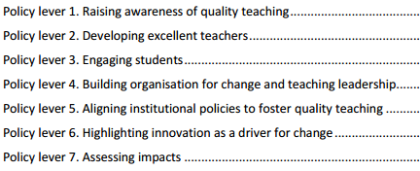
Teaching Culture – Initial Elements
Teaching is recognized in strategic initiatives and practices
Assessment of teaching is constructive and flexible
Faculty are encouraged to develop as teachers
Infrastructure exists to support teaching
Broad engagement around teaching occurs
http://www.oecd.org/edu/imhe/QT%20policies%20and%20practices.pdf

Slide 7
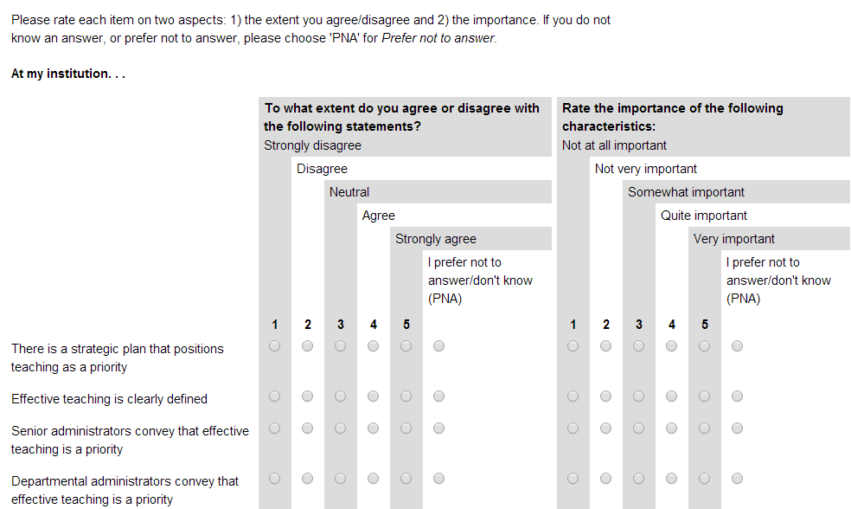
Phase 1: Pilot Study–Teaching Culture Perception Survey (TCPS)
Assessment of agreement and importance ratings

Slide 8
Phase 1 – TCPS & Focus Groups
Two versions of the survey
  Students: Graduate & undergraduate
  Faculty & Administration
Pilot survey at:
  Windsor (921 participants)
  Western (1589 participants)
  McMaster (1334 participants)
Focus groups ran to collect feedback
on the survey and input on quality
teaching culture at each institution.
Faculty & Administration

Slide 9
Next Steps…
Revise survey (levers and items)
Develop staff version
Validation and establishment of norms
Notes:
The overall project is an important long term change management opportunity. Following completion of the formal proposed project, we plan to continue with focus groups to assess the face validity of the QCPI tool and indicators and to gather feedback about the process and utility of the report received. This portion of the project will be funded through other sources and in kind support.
Erika 30 secs

Slide 10
Next Steps…
Expand focus of research (e.g., outside Ontario, include colleges)
Develop manual with recommendations to improve institutional teaching cultures
Secure more funding
Notes:
The overall project is an important long term change management opportunity. Following completion of the formal proposed project, we plan to continue with focus groups to assess the face validity of the QCPI tool and indicators and to gather feedback about the process and utility of the report received. This portion of the project will be funded through other sources and in kind support.
Erika 30 secs

Slide 11
Questions…???
Webpage: qualityteachingculture.wordpress.com
Paola Borin
Deb Dawson
Florida Doci
Donna Ellis
Lori Goff
Jill Grose
Sandy Hughes
Erika Kustra
Ken Meadows
Peter Wolf

Slide 12
References
  Burke, J. C. (1998). Performance funding indicators: Concerns, values, and models
  for state colleges and universities. New Directions for Institutional Research,
  97, 49 – 60.
Chalmers, D. (2008). Teaching and Learning Quality Indicators in
  Australian Universities, Conference proceedings of Institutional Management in Higher Education (IMHE), Paris France, September 8-12.
Denison, D. R. (1996). What is the difference between organizational culture
and organizational climate? A native’s point of view on a decade of paradigm wars. Academy of Management Review, 21(3), 619 – 54.
Hénard, F. & Roseveare, D. (2012). Fostering quality teaching in higher
education: Policies and practices. France: Organization for Economic Co-operation and Development.
Warglien, M., & Savoia, M. (2001). Institutional Experiences of Quality
Assessment in Higher Education - The University of Venice (Italy).Organisation for Economic Cooperation and Development (OECD).

