Slide 1








Institutional and Provincial Teaching Indicators
Barry Joe /
Jill Grose
Peter Wolf/
Alexander Legwegoh
Sandy Hughes
Lori Goff
Discussion
Paola Borin
Donna Ellis
Deb Dawson
Erika Kustra
Notes:
slides 1 – 6 In tro and Context - Peter– 10 mins
Slide 7-10 - Deb – Self-assessment and debrief – 30 mins
Slide 11-15 - Lori – Background – 10 mins
Slides 16-18 Peter – Indicators exercise – 20 mins
Slide 19 – Peter - Session debrief 10 mins

Slide 2
Agenda
Articulate our project
Approach 1: Self-Study/Survey
The Quality Revolution
Approach 2: Indicators
Suggestions

Slide 3
Where we are
Articulating the project
Environmental scan
Developing and validating measures/indicators
Piloting
Recommendations
In progress…
Yet to come…

Slide 4
ENHANCING STUDENT ACHIEVEMENT OF LEARNING OUTCOMES
Individual
Quality Learning
Culture
Curriculum
Institutional
Individual
Quality Teaching
Culture
Curriculum
Institutional

Slide 5
TRYING TO ARTICULATE TEACHING QUALITY CUlture
Individual
Quality Teaching
Culture
Curriculum
Institutional
STUDENT EVALUATIONS, PEER REVIEW, SOTL, ETC
PROGRAMME REVIEWS, ACCREDITATION, CONTINUOUS IMPROVEMENT, ETC
INDICATORS, ACCREDITATION, ETC

Slide 6
United Kingdom
Umap
(http://www.u-map.eu/finder.shtml)
Teaching and Learning:
  Subject areas covered
  Degree level focus
  Orientation of degree
  Expenditure on teaching
Student profile
  Mature, part-time, distance
Knowledge exchange
  Start-ups, patents, cultural, income
International orientation
  Exchange & Foreign degree seeking students, Non-national academic staff, Income from international sources
Research involvement
  Peer reviewed & Professional publications, Other research output, Doctorate production, Expenditure on research
Regional engagement
  Graduates, New entrants, Income
Notes:
UK - On the first of November 2010, the fourth U-Map Lifelong learning project started. The work carried out in the three previous projects to design a European classification of higher education institutions has produced a set of tools that can be used to enhance the transparency of the European higher education area (EHEA). The U-Map classification has been presented to international audiences and its tools are seen as an innovative and intelligent way to characterise higher education institutions. To create this impact, the U-Map classification needs to cover a substantial proportion of European higher education institutions.

Slide 7
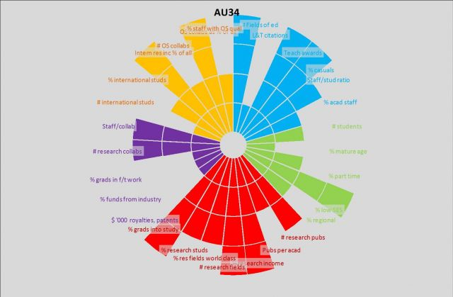
Australia's New Accountability Tool
L&T Citations
Teaching Awards
% Casuals
Staff/Student Ratios
% Academic Staff
http://www.insidehighered.com/news/2013/02/13/australia-adapts-european-union-tool-comparing-universities

Slide 8
Challenge
How can we encourage the ongoing development of institutional cultures that recognize, value, promote, and continuously enhance a high standard of teaching and a high standard of student learning?
One possibility:
By developing tools that measure the value that an institution places on teaching.

Slide 9
What is Quality Teaching?
The use of pedagogical techniques to produce learning outcomes for students (Hénard & Roseveare, 2012).
Pedagogical techniques include: effective curriculum and course design, feedback on teaching, assessment of learning outcomes and a variety of educational practices.
Support for quality teaching must take place at three inter-dependent levels:
  Institutional Level
  Program Level
  Individual Level

Slide 10
A Tool for Assessing
Quality Teaching
Institutional Management of Higher Education (IMHE) has prepared a guide for higher education institutions to assist university leaders in fostering quality teaching.
  Fostering Quality Teaching in Higher Education: Policies and Practices An IMHE Guide for Higher Education Institutions (Hénard & Roseveare, 2012)
Provides approaches, practices and policy levers that will improve the support of quality teaching.
Includes a questionnaire for self-assessment and tool for reflective discussion.
Self-assessment and reflection questions are organized within seven policy levers.

Slide 11
Fostering
Quality Teaching
Policy Levers
  Raising Awareness of Quality Teaching
  Developing Excellent Teachers
  Engaging Students
  Building Organization for Change and Teaching Leadership
  Aligning Institutional Policies to Foster Quality Teaching
  Highlighting Innovation as a Driver for Change
  Assessing Impacts
Activity: Complete adapted self-assessment and reflect on the priorities and challenges at your institution.

Slide 12
Why quality? Why now?
The higher education sector is experiencing
quality revolution
where quality has become a sudden focus
1980s
1990s
2000s
now
Notes:
Quality itself is not a new issue, but rather it is the collective formalization of quality through quality assurance systems that is new (Harvey, 2007) and has led to the quality revolution we have experienced since the 1990s (Newton, 2010)

Slide 13
Massification of Education
Elite
Mass
Universal
<15%
15-50%
50% +
Trow, M . (1973). Problems in the transition from elite to mass higher education. Berkeley, CA: Carnegie Commission on Higher Education Reprint

Slide 14


Massification of Education
Most educated country; 51% attained PSE
OECD (2012), Education at a Glance OECD Indicators, OECD Publishing>
64% attained PSE; striving for 70%
(Open Ontario Plan, Speech from the Throne, March 2010)

Slide 15
Focus on Assuring Quality
Quality Assurance
QA
Scholarship of
Teaching & Learning
SoTL
Quality Enhancement
QE

Slide 16
Measuring “Quality”
Reputation
Ranking – e.g., McLeans (based on the opinion of university administrators, research publications, grants received)
Performance Indicators – Incoming GPA, Applications to registrants, enrolment, persistence, library budget, student support, employment success
Indirect measures – Grades
Standardized measures – Collegiate Learning Assessment (CLA)
Surveys – NSSE, Student Evaluations of Teaching (a form of direct measure)
Direct measures of learning – portfolios, performance
But WHAT are we actually measuring?

Slide 17
Measuring/Indicators of
“Teaching Quality”
Measure | Working Definitions | Examples
Indicators | “A quantitative or qualitative factor or variable that provides a simple and reliable means to measure achievement, to reflect changes connected to an intervention, or to help assess the performance of a development actor” (DAC Glossary of Key Terms in Evaluation, May 2002) | Incoming GPA, Applications to registrants, enrolment, persistence, library budget, student support, employment success
Surveys | A self-report study is a type of survey, questionnaire, or poll in which respondents read the question and select a response by themselves without researcher interference. A self-report is any method which involves asking a participant about their feelings, attitudes, beliefs and so on. (http://en.wikipedia.org/wiki/Self-report_study, Feb 2013) | NSSE, graduate surveys

Slide 18
What about Indicators?
Notes:
Give out handout and get ffeedback

Slide 19
Feedback
Are the indicators listed appropriate in our context?
Is there anything missing/overemphasized?
Other comments
Overall recommendations for us to consider…

Slide 20
Suggestions…?
Indicators, survey/self-study or hybrid

Slide 21
Where we are
Articulating the project
Environmental scan
Developing and validating measures/indicators
Piloting
Recommendations

Slide 22
Institutional and Provincial Teaching Indicators
Barry Joe /
Jill Grose
Peter Wolf/
Alexander Legwegoh
Sandy Hughes
Lori Goff
Discussion
Paola Borin
Donna Ellis
Deb Dawson
Erika Kustra

