Slide 1


Advancing Teaching Culture at Your University: Evidence-based Indicators and Strategies
November 8, 2022
Notes:
Erika- welcome
Land acknowledgement – ask others to add their acknowledgements to the chat
The University of Windsor sits on the traditional territory of the Three Fires Confederacy of First Nations, which includes the Ojibwa, the Odawa, and the Potawatomi. We respect the longstanding relationships with First Nations people in this place in the 100-mile Windsor-Essex peninsula and the straits – les détroits – of Detroit.
Not recording – slides will be made available

Slide 2
Agenda
Welcome
Overview of Teaching Culture Research and Tools
Breakout Activities
  Reflecting on your Teaching Culture
  Enhancing your Teaching Culture
Next Steps and Ways to Engage
Notes:
Erika

Slide 3





Research Team Members
Research Associates
Lindsay Shaw (Brock University)
Kristin Brown (University of Waterloo)
Catharine Dishke Honzel (Western University)
Florida Doci (University of Windsor)
Danielle Gabay (McMaster University)
Jake Kaupp (Queen’s University)
Research Assistants
Samantha Burton (University of Windsor)
Carly Del Pup (University of Windsor)
Hoda Eiliat (student - University of Windsor)
Kaitlyn Gillard (student - University of Windsor)
Legwegoh, Alexander (University of Guelph)
Gayle McIntyre (Western University)
Rebeca Lee (McMaster University)
Karyn Olsen (Toronto Metropolitan University)
Naseem Sherwani (McMaster University)
Abeer Siddiqui (McMaster University)
Melec Zeadin (McMaster University)
Lead
Erika Kustra (University of Windsor)
Co-Investigators
Joseph Beer (Wilfred Laurier University)
Paola Borin (Toronto Metropolitan University)
Debra Dawson (Western University)
Donna Ellis (University of Waterloo)
Lori Goff (McMaster University)
Madelyn Law ( Brock University)
Ken Meadows (Western University)
Peter Wolf (Independent)
Jill Grose (Brock University)
Sandy Hughes (Wilfred Laurier University)
Lynn Taylor (University of Calgary)
Notes:
Erika
Bolded - continuing team members
Purple font – session facilitators
Thank Karen Simmavong and Lisa Ouellette from Western helping with the session today
Ask team to introduce themselves briefly
There have been 12 investigators on this project from 8 eight universities ( active members are highlighted) plus numerous Research associates and Research assistants. Our current research associate is Lindsay Shaw.

Slide 4
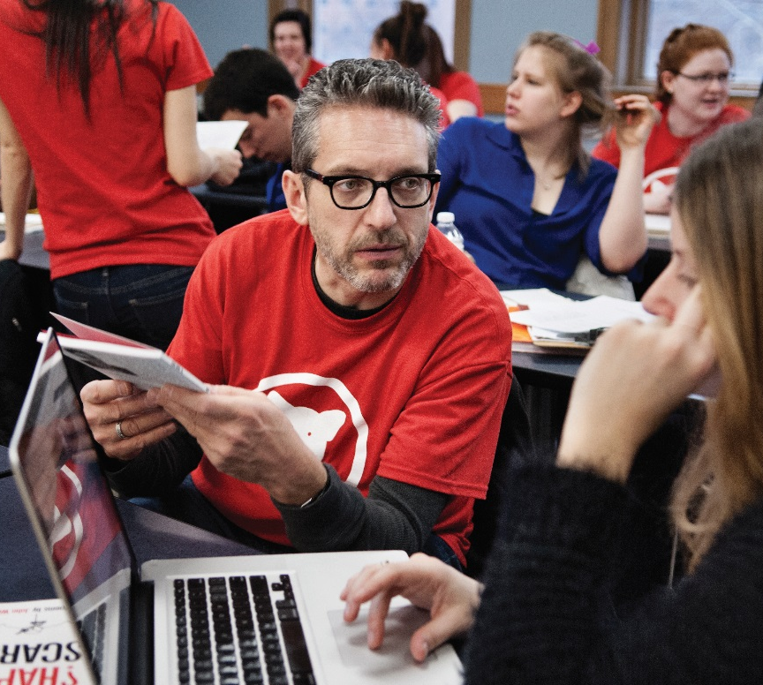
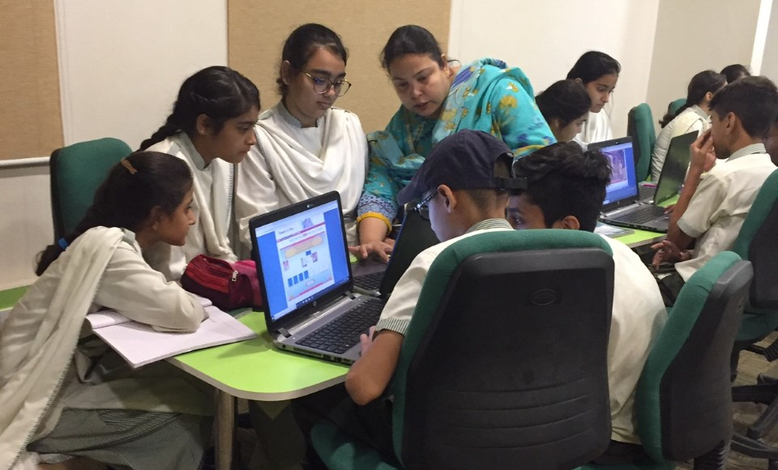
How would you define high-quality teaching in your institution?
(Waterfall Chat: Type in chat, but don’t release until the signal!)
Notes:
Erika
Waterfall answers in chat
Read back a few. Capture text in chat to share later.
Then ask “What is a teaching culture?” Rhetorical question to lead into next slide.

Slide 5

Teaching Culture
is the product of embedded patterns, behaviours, shared values, beliefs and ideologies around teaching in higher education
(Cox et al., 2011; Kustra et al., 2014, ; Mårtensson & Roxå, 2016).
Critical Outcomes
Student Learning
(Cox et al., 2011)
Student Engagement
(Grayson & Grayson, 2003)
Student Retention
(Berger & Braxton, 1998)
Faculty Motivation
(Feldman & Paulsen, 1999)
Notes:
Madelyn
-Teaching culture: a culture demonstrating teaching is valued (Kustra et al, 2014)

Slide 6
Why does a Teaching Culture Matter?
Contributes to a shared campus commitment to teaching excellence
Impacts student learning, student engagement, and student retention
Influences faculty motivation and behavior
Impacts quality teaching
Berger & Braxton, 1998; Bergquist & Pawlak, 2008;
Cox et al., 2011; Feldman & Paulsen, 1999; Grayson & Grayson, 2003
Hénard & Roseveare, 2012; Prosser, 2013
Notes:
Madelyn

Slide 7
Teaching Culture - Guiding Principles
Context.
  Teaching culture emerges from the interplay of factors that are unique to each institution
Collaboration.
  Cultivating a positive teaching culture is a responsibility shared by individual teachers and learners, their programs and their institutions.
Focus on learning.
  Many different ways to nurture a productive teaching and learning culture.
  Most effective strategies will be those that focus on learning and on assessment practices
Notes:
Erika
Teaching culture.
individual teachers have the most direct impact on the learning experiences of their students
teaching and learning take place in institutional contexts that influence whether and how teachers and students can do their best work.
Context-. Similarly, the interpretation of and responses to survey results will have the strongest impact when they are generated with that context in mind.
Collaboration-Meaningful, inclusive and respectful conversations at the institutional, Faculty and departmental levels about teaching and learning lie at the heart of developing a supportive institutional teaching culture.
Focus on Learning -The most effective strategies will be those that focus on learning – of students, teachers and institutions – and on assessment practices that support the development of learners, teachers, academic programs and the institutions that support them

Slide 8
A culture that values teaching has:
A shared campus commitment to teaching
Meaningful and constructive evaluation of teaching
Broad engagement (students, faculty, stakeholders)
Hiring and promotion practices related to teaching
Infrastructure
Support for teacher development
Teachers who use good practices
Recognition of good teaching
Opportunities to develop teaching leadership
Institutional policies to foster quality teaching
Regular assessment of impact for improvement
(Henard & Roseveare, 2012; Kustra, et al, 2014; Paulsen & Feldman, 1995)
Notes:
Erika

Slide 9
Teaching Culture Perception Framework
(Kustra et al., 2014)
Lever 1 Strategic Documents & Initiatives Prioritize Effective Teaching
The importance of quality teaching is emphasized in initiatives, policies, and practices and by the administration
Lever 2 Assessment of Teaching is Constructive and Flexible
Teaching quality is assessed both formatively and summatively, and in multiple ways
Lever 3 Effective Teaching is Implemented
Instructors design and teach their courses in ways that support student learning
Lever 4 Infrastructure Exists to Support Teaching
Facilities and resources that support quality learning experiences are available
Lever 5 Broad Engagement Occurs Around Teaching
Members of the institution and larger community are involved in initiatives that foster quality learning experiences
Lever 6 Effective Teaching is Recognized and Rewarded
Teaching excellence is a priority that is acknowledged and honoured
Notes:
Erika

Slide 10
Teaching Culture Perception Tools
Tools were developed from a framework of indicators that support quality teaching
Tools intended to assess perceptions of teaching culture over time for different stakeholder groups
Notes:
Ken

Slide 11
Teaching Culture Perception Tools
Three sets of tools
  Institutional Teaching Culture Perception Surveys (ITCPS) assess perceptions of institutional teaching culture for faculty, students, and staff (3 versions)
  Unit-level Teaching Culture Perception Surveys (UTCPS) assess perceptions of teaching culture at the division or unit level, such as the School, Faculty, or Departmental level, for faculty, students, and staff (3 versions)
  Teaching Culture Reflective Tool (TCRT) helps stakeholders take a reflective approach to understanding and enhancing the teaching culture at their institution or their division within their institution
Notes:
Ken

Slide 12
Teaching Culture Perception Tools: ITCPS & UTPCS
ITCPS & UTCPS:
3 versions
    Faculty (37 items)
    Students (undergraduate & graduate; 31 items)
    Staff who support teaching & learning (33 items)
Items rated twice:
  Agreement: Very low agreement (1) to Very high agreement (5)
  Importance for the respondent: Very low importance (1) to Very high importance (5)
  Don’t Know response option
  Example item: “At my institution, instructors adopt a variety of approaches to teaching and learning.”
Notes:
Ken

Slide 13
Teaching Culture Perception Tools: TCRT
TCRT:
Reflective guide with 56 items, based on surveys, to help understand and enhance teaching culture at the institution or division
Items rated for agreement: Yes, At times, No
Example item: “In my context, learning spaces such as classrooms, labs and/or studios are designed to support learning.”
Notes:
Ken

Slide 14
Activity 1: Reflecting on your Teaching Culture
How?
  Randomly-selected self-facilitated breakout rooms
How long?
  20 minutes
What will you do?
  Our opportunity to explore and discuss 1 lever (6 levers with 2 groups each)
How will you engage?
  Review the lever/indicators and consider the guiding questions at https://bit.ly/3CWeT0c
How will we capture and share our learning?
  Have one person notetaking in the doc
Notes:
Ken
In breakout rooms, introduce selves
Might have one person write responses in the google doc
Random assignment, 12 rooms (2 for each lever)
Facilitators drop into their two lever rooms
Google doc – with questions – groups provide notes
Two rounds
Slightly different questions across the two rounds
Round 1 – definitional, what is this lever, how does this look at your institution, is this a strength? More descriptive.
Round 2 – what practices will enhance this lever within your context? More action orientated.
1 person per group to write on google doc
1 google doc – with 6 sections – 1 for each lever –
2 groups working with each lever
Top of google doc – room 1 – Lever 1
Room 2 – Lever 1
Room 3 – Lever 2
Room 4 = Lever 2…
Etc….
Need to set up backchannel for facilatators – Teams, cellphones????

Slide 15
Activity 1 Questions
Clarification - What are your reflections on the indicators for your lever? What questions, if any, do you have about the lever and its indicators?
Perception - To what extent do you agree that the indicators apply to your institution? How might the different stakeholders at your institution - students, faculty, and staff who support teaching and learning - differ in their perceptions of the applicability of the indicators?
(if you have time)
Adaptations - What, if anything, would you add, edit, or delete related to the indicators, based on your experience/institutional context?
Review the lever (and indicators).
Please add your comments in our shared document.
Notes:
Ken

Slide 16
Activity 2: Enhancing your Teaching Culture
How?
  Randomly-selected self-facilitated breakout rooms
How long?
  20 minutes
What will you do?
  Our opportunity to explore how we might enhance 1 lever (6 levers with 2 groups each)
How will you engage?
  Consider the guiding questions at https://bit.ly/3TdUNDv
  Resource you may consider - Effective Practices Online Repository
How will we capture and share our learning?
  Have one person notetaking in the doc
Notes:
Ken
Back in main room, introduce second activity
Introduce selves
One person write

Slide 17
Activity 2 Questions
Clarification - What are your reflections on the indicators for your lever? What questions, if any, do you have about the lever and its indicators?
Practices - What practices might enhance this lever within your context? How might you/your institution concretely enhance its teaching culture.
(if you have time)
Process/Approaches - What processes/approaches do you think would work most effectively and efficiently to positively impact your teaching culture?
Review the lever (and indicators), as well as the notes taken by the previous group (top of our shared document) –
May consider the Effective Practices Online Repository.
Notes:
Ken

Slide 18
Teaching Culture Perception Framework
(Kustra et al., 2014)
Lever 1 Strategic Documents & Initiatives Prioritize Effective Teaching
The importance of quality teaching is emphasized in initiatives, policies, and practices and by the administration
Lever 2 Assessment of Teaching is Constructive and Flexible
Teaching quality is assessed both formatively and summatively, and in multiple ways
Lever 3 Effective Teaching is Implemented
Instructors design and teach their courses in ways that support student learning
Lever 4 Infrastructure Exists to Support Teaching
Facilities and resources that support quality learning experiences are available
Lever 5 Broad Engagement Occurs Around Teaching
Members of the institution and larger community are involved in initiatives that foster quality learning experiences
Lever 6 Effective Teaching is Recognized and Rewarded
Teaching excellence is a priority that is acknowledged and honoured
Notes:
Erika – say something debrief-y

Slide 19
Next Steps for Our Group
ITCPS-F (faculty): Manuscript of validation study submitted for review
ITCPS-S (student): Manuscript of validation study under preparation
UTCPS: Validation studies being planned
Weave Equity, Diversity, Inclusion, Decolonization, Indigenization, and Accessibility throughout the tools
Surveys adapted to French, college context
Continued dissemination and use
Notes:
Erika – say something debrief-y

Slide 20
Next Steps for Participants
Opportunity for adoption of ITCPS, UTCPS, and TCRT
Partner on validation of UTCPS
Try out the Reflective Guide
More information:
https://qualityteachingculture.ca/
Questions:
kustraed@uwindsor.ca
lshaw2@brocku.ca
peter.allan.wolf@gmail.com
Notes:
Erika

Slide 21
References
Berger, J.B., & Braxton, J.M. (1998). Revising Tinto’s interactionalist theory of student departure through theory elaboration: Examining the role of organization attributes in the persistence process. Research in Higher Education, 39(2), 103-119.
Bergquist, W. H., & Pawlak, K. (2008). Engaging the six cultures of the academy. Jossey-Bass.
Cox, B.E., McIntosh, K.L., Reason, R.D., & Terenzini, P.T. (2011). A culture of teaching: Policy, perception, and practice in Higher Education. Research in Higher Education, 52, 808-829.
Feldman, K. A., & Paulsen, M. B. (1999). Faculty motivation: The role of a supportive teaching culture. Newdirections for teaching and learning, 1999(78), 69-78. doi: 10.1002/tl.7807
Grayson, J.P., & Grayson, K. (2003). Research on retention and attrition (No. 6). Montreal QC: The Canadian Millennium
Scholarship Foundation.
Hénard, F., & Roseveare, D. (2012). Fostering quality teaching in higher education: Policies and practices - An IMHE guide for higher education institutions. Paris, France: Organisation for Economic Co-op-eration and Development.
Kustra, E., Doci, F., Meadows, K.N., Dawson, D., Dishke-Honzel, C., Goff, L.,…Hughes, S. (2014). Teaching culture indicators: Enhancing quality teaching. Report to the Ministry of Training, Colleges and Universities Productivity and Innovation Fund
Program, University of Windsor, ON.
Paulsen, M. B., & Feldman, K. A. (1995). Taking teaching seriously: Meeting the challenge of instructional improvement. ASHE-ERIC Higher Education Report No. 2. Washington, DC: The George Washington University Graduate School of Education and Human Development.
Prosser, M. (2013). Quality teaching quality learning. In D. J. Salter (Ed.), Cases on quality teaching practices in higher education (pp. 26-37). IGI Global.

Slide 22


Contact Us
Erika Kustra, PhD
Project Lead, Institutional Teaching Culture Project
Director, Centre for Teaching and Learning, University of Windsor
kustraed@uwindsor.ca
Lindsay Shaw, MA
Research Coordinator, Institutional Teaching Culture Project
Academic Advisor, Brock University
lshaw2@brocku.ca

Slide 23
Lever 1 Indicators: Strategic Documents and Initiatives Prioritize Effective Teaching
Teaching is considered a priority in the primary institutional strategic plan
Effective teaching is clearly defined in institution-wide documents
Senior administrators convey that effective teaching is an institutional priority
Institution-wide initiatives promote innovative teaching practices
Most instructors consider effective teaching to be a priority
Institutional policies recognize effective teaching in the evaluation of job performance
Staff supporting/enhancing teaching are regarded as an important resource for instructors and educational administrators
Notes:
Slides 22 to 28 for reference - not part of the presentation.

Slide 24
Lever 2 Indicators: Assessment of Teaching is Constructive and Flexible
Students are invited to provide feedback to their instructors in addition to end of course evaluations
Students are invited to provide feedback on course design
Student feedback on teaching is taken into consideration in hiring, promotion and tenure practices
Student feedback on teaching is taken into consideration to improve teaching
The response to student feedback is shared back with students
Student learning outcomes are considered in program evaluation
Teaching is formally assessed in multiple ways through the lenses of multiple stakeholders (student, faculty, staff)
Course design is considered in the assessment of teaching
Instructors have some influence over how their teaching is assessed
Professional staff are invited to provide feedback on course design

Slide 25
Lever 3 Indicators: Effective Teaching is Implemented
Instructors tell their students how they use student feedback to improve teaching
Instructors have developed and communicate teaching and assessment methods that align with the learning outcomes of their course
Instructors tell their students how their course fits into the curriculum toward a degree
Instructors access the services and resources provided to support their development as teachers
Instructors are encouraged to spend time developing their teaching
Instructors are encouraged to use evidence about teaching to inform their teaching practices
Instructors think of creative or unique ways to engage students in the course material
Instructors communicate how course content is relevant to the workplace and future careers
Staff who support teaching contribute to the development and implementation of effective teaching

Slide 26
Lever 4 Indicators: Infrastructure Exists to Support Teaching
Learning spaces such as classrooms, labs and/or studios are designed to support learning
Instructors have access to adequate materials/ supplies to provide a good learning environment
Instructors have access to resources to help them facilitate technology-enabled learning
Instructors have access to resources and support to improve their teaching
Instructors use technology effectively to support student learning
Instructors use technology in new and innovative ways to facilitate student learning
Instructors can get financial support to develop their teaching
Staff who support teaching are encouraged to develop their expertise in their role
Staff who support teaching can get financial support to develop their expertise in their role

Slide 27
Lever 5 Indicators: Broad Engagement Occurs Around Teaching
Students are involved in activities that foster effective teaching across the institution
Instructors discuss ways to improve the student learning experience with their colleagues
External stakeholders such as alumni, employers and/ or community members are involved in initiatives that foster effective teaching across the institution
Professional staff such as library staff, educational developers, learning support student services, etc. are involved in initiatives that foster effective teaching
Teaching assistants provide effective support for student learning
Collaborative approaches to teaching are valued
Teaching practices are discussed across the institution through a range of mechanisms
Opportunities exist for instructors to lead initiatives that enhance teaching beyond their own instruction

Slide 28
Lever 6 Indicators: Effective Teaching is Recognized and Rewarded
Evidence of effective teaching is recognized in the evaluation of job performance
There are institutional rewards for effective teaching
Teaching accomplishments, contributions, and/or awards are publicized and/or celebrated
Effective teaching is valued in the hiring processes
Unit level administrators reward effective teaching as a priority
Research on teaching is recognized in the evaluation of job performance
There is institutional recognition for staff who support teaching

Slide 29
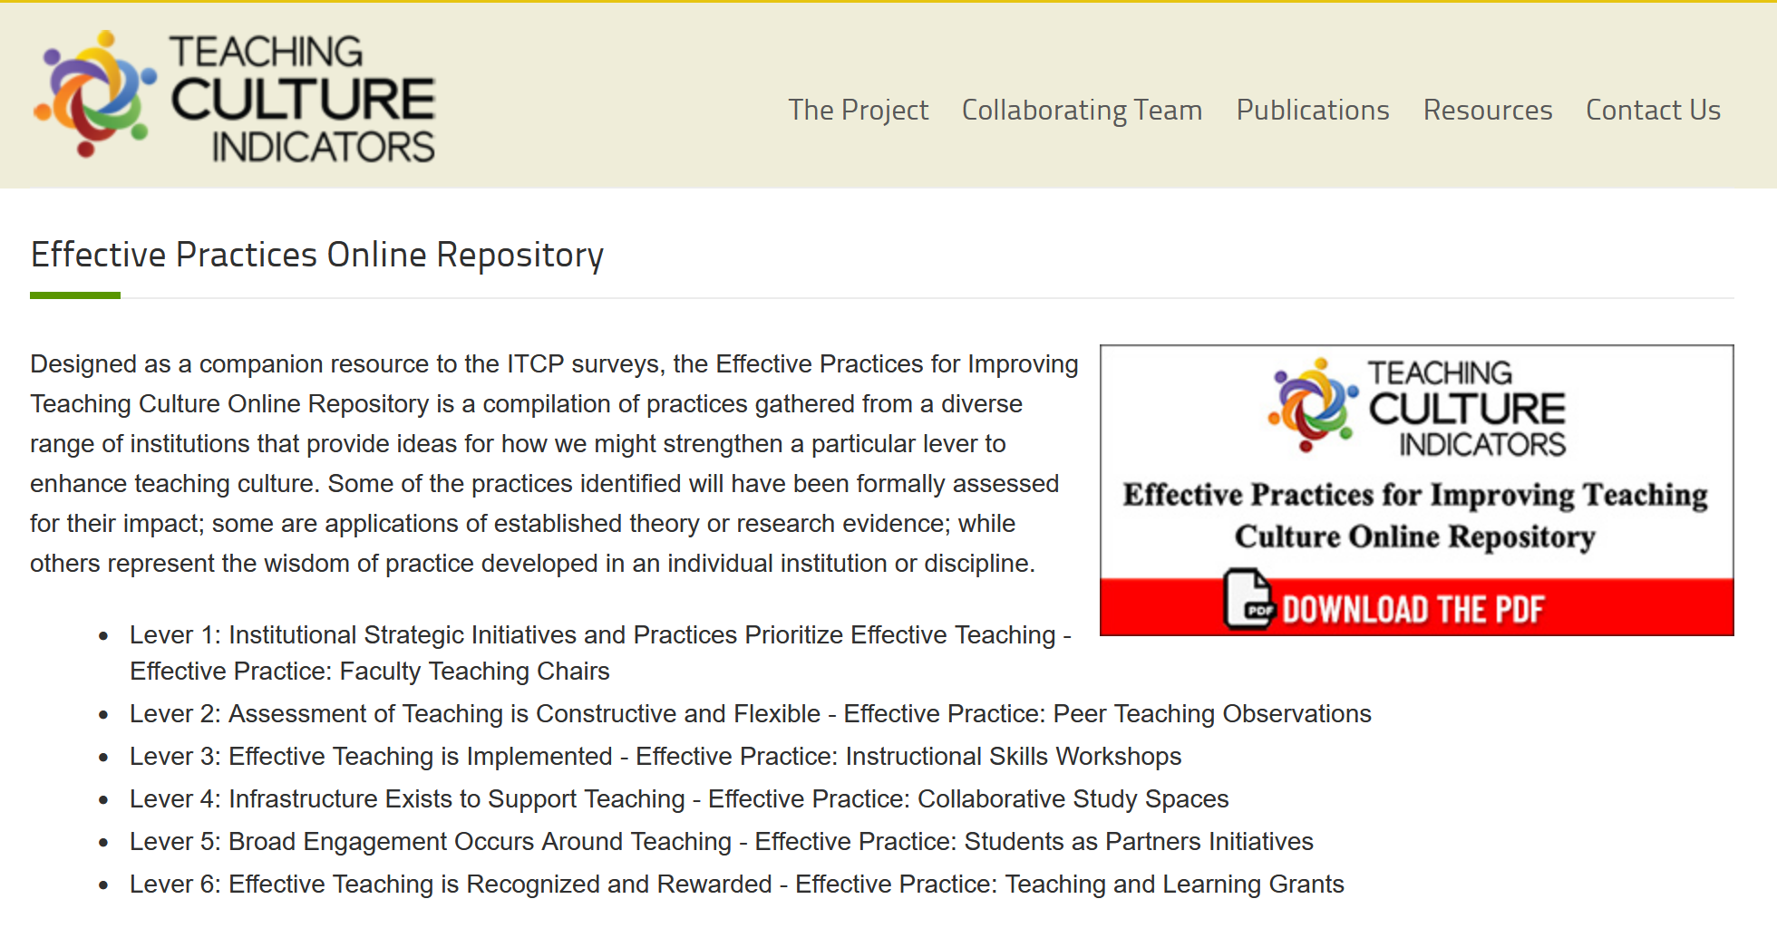
Effective Practices Repository

