Slide 1

Enhancing Our Understanding of Institutional Teaching Culture
Peter Wolf (peter.allan.wolf@gmail.com)
Donna Ellis (donnae@uwaterloo.ca)
Erika Kustra (kustraed@uwindsor.ca)
October 26, 2017

Slide 2









Collaborating Team
Erika Kustra, PhD (Lead Researcher)
Director, Teaching and Learning Development
Centre for Teaching and Learning
University of Windsor
Joseph Beer, PhD (Co-Investigator)
Director (Acting), Centre for Teaching Innovation and Excellence
Wilfrid Laurier University
Paola Borin, MEd (Co-Investigator)
Curriculum Development Consultant
Ryerson University
Debra Dawson, PhD (Co-Investgator)
Director, Teaching and Learning Services
Chair, Educational Developers Caucus
Western University
Donna Ellis, PhD (Co-Investigator)
Director, Centre for Teaching Excellence
University of Waterloo
Lori Goff (Co-Investigator)
Educational Consultant, Centre for Leadership in Learning
McMaster University
Jill Grose, PhD (Co-Investigator)
Director, Centre for Pedagogical Innovation
Brock University
Ken N. Meadows, PhD (Co-Investigator / Statistical Analysis)
Educational Researcher, Teaching and Learning Services
Western University
Lynn Taylor, PhD (Co-Investigator)
Vice-Provost (Teaching and Learning)
University of Calgary
Peter Wolf (Co-Investigator)
Educational Consultant
Lindsay Shaw, MA Candidate (Project Coordinator)
University of Windsor
Kristin Brown, MSc (Research Assistant)
University of Waterloo
Jake Kaupp, PhD (Data Visualizer)
Assessment and Quality Assurance Coordinator
Queen’s University

Slide 3
Agenda
Defining & explicating teaching culture
Selected findings - results & validation
Results visualization

Slide 4

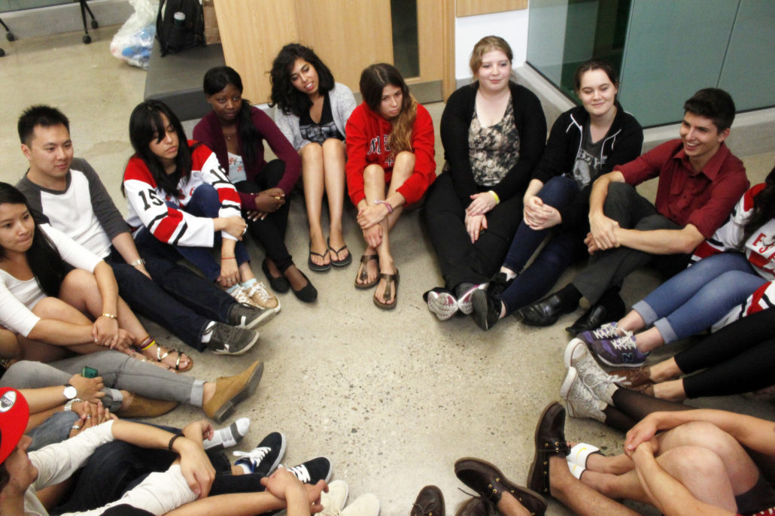

What is a teaching culture?
Institutional culture: embedded patterns, behaviours, shared values, beliefs, and ideologies which help define educator and learner experiences, and can have numerous micro-cultures (Cox et al., 2011; Kustra et al. 2014; Mårtensson & Roxå, 2016)
Teaching culture: an institutional culture demonstrating teaching is valued (Kustra et al, 2014)

Slide 5
Why does a teaching culture matter?
Contributes to a shared campus commitment to teaching excellence
Impacts student learning, student engagement, and student retention
Influences faculty motivation and behavior
Impacts finances
Berger & Braxton, 1998; Bergquist & Pawlak, 2008;
Cox et al., 2011; Feldman & Paulsen, 1999; Grayson & Grayson, 2003

Slide 6

Culture eats strategy for breakfast.
Every time.
- Drucker

Slide 7
Teaching Culture Perception Survey
1
Institutional, strategic initiatives & practices prioritize effective teaching
2
Assessment of teaching is constructive & flexible
3
Implementing effective teaching
4
5
Infrastructure exists to support teaching
6
Broad engagement around teaching
Effective teaching is recognized & rewarded
Agreement
Importance

Slide 8
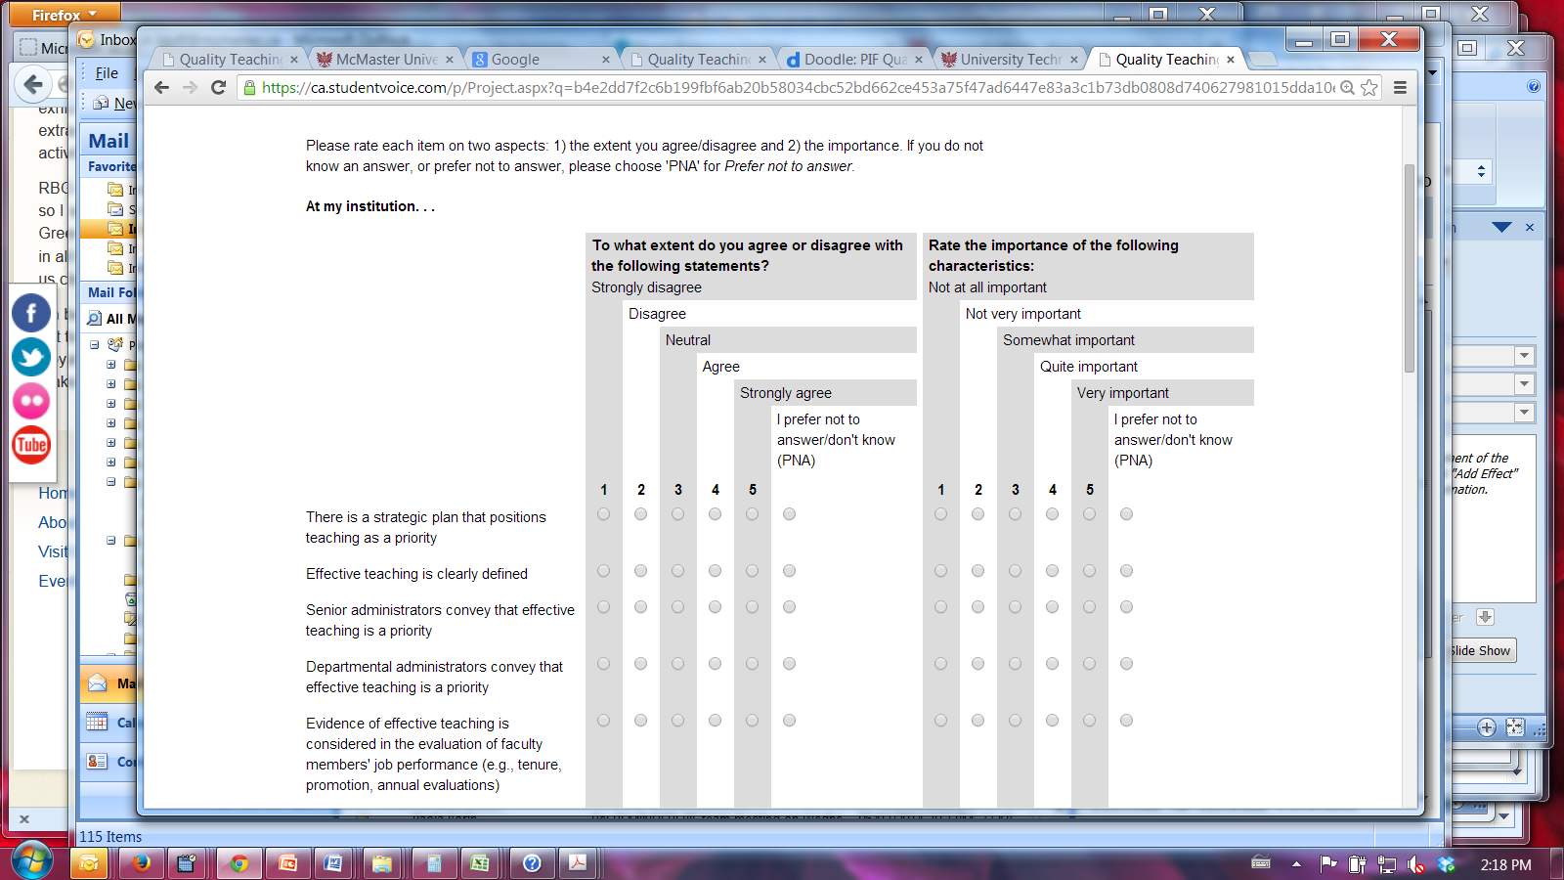
Teaching Culture Perception Survey

Slide 9
Teaching Culture Perception Survey
Three versions of the survey and focus groups​
Students: graduate and undergraduate​
Faculty and administrators​
Professional Staff (new)​
​
Phase 1: Pilot faculty and student (Ministry Funded)​
Windsor ( 921 participants)​
Western (1589 participants)​
McMaster (1334 participants)​
​
Phase 2: Revision & Validation, Pilot staff (SSHRC Funded)​
Queen’s (747 participants)​
Waterloo (1895 participants)​
Calgary (this Fall)​

Slide 10
Validation Results: Faculty
Means
  Agreement: 2.88 (Lever 2) to 3.40 (Lever 1)
  Importance: 3.68 (Lever 5) to 4.33 (Lever 1)
Correlations with Teaching Satisfaction (TS)
  Agreement: r’s = 0.31 (Lever 6) to 0.51 (Lever 4)
  Importance: r’s = 0.09 (Lever 4) to 0.27 (Lever 1)
Regression: Agreement Lever 4 and Importance Lever 1 best predict TS (R² = .30)

Slide 11
Validation Results: Undergraduate Students
Means
  Agreement: 3.18 (Lever 3) to 3.80 (Lever 4)
  Importance: 3.84 (Lever 5) to 4.29 (Lever 1)
Correlations with Emotional Engagement (EE)
  Agreement: r’s = 0.22 (Lever 4) to 0.39 (Lever 1)
  Importance: r’s = 0.11 (Lever 1) to 0.29 (Lever 6)
Regressions: Agreement Lever 1 and Importance Lever 6 best predict EE (R² = .21)

Slide 12
Validation Results: Graduate Students
Means
  Agreement: 3.25 (Lever 3) to 3.88 (Lever 4)
  Importance: 3.95 (Lever 5) to 4.29 (Lever 4)
Correlations with Emotional Engagement (EE)
  Agreement: r’s = 0.28 (Lever 4) to 0.40 (Lever 5)
  Importance: r’s = 0.06 (Lever 2) to 0.17 (Lever 4)
Regressions: Agreement Lever 5 is the only significant predictor in the regression for EE (R² = .16)

Slide 13
Implications of the Findings
Teaching and learning are valued
There is a consistent gap between agreement and importance = key area for organizational development
What happens at an institution matters more to teaching satisfaction and emotional engagement than what we say
  For faculty: need to provide infrastructure and policies and practices to support effective teaching
  For students: need to hear about institutional initiatives that prioritize effective teaching and be involved in teaching as TAs and researchers

Slide 14
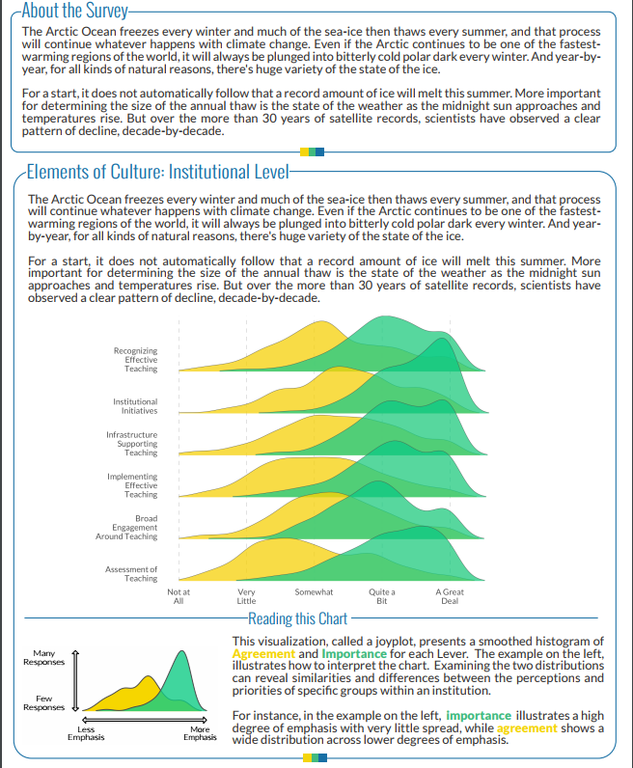

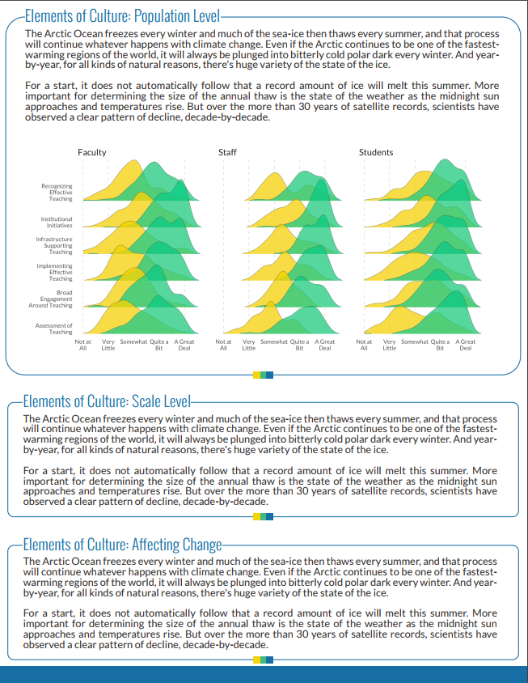
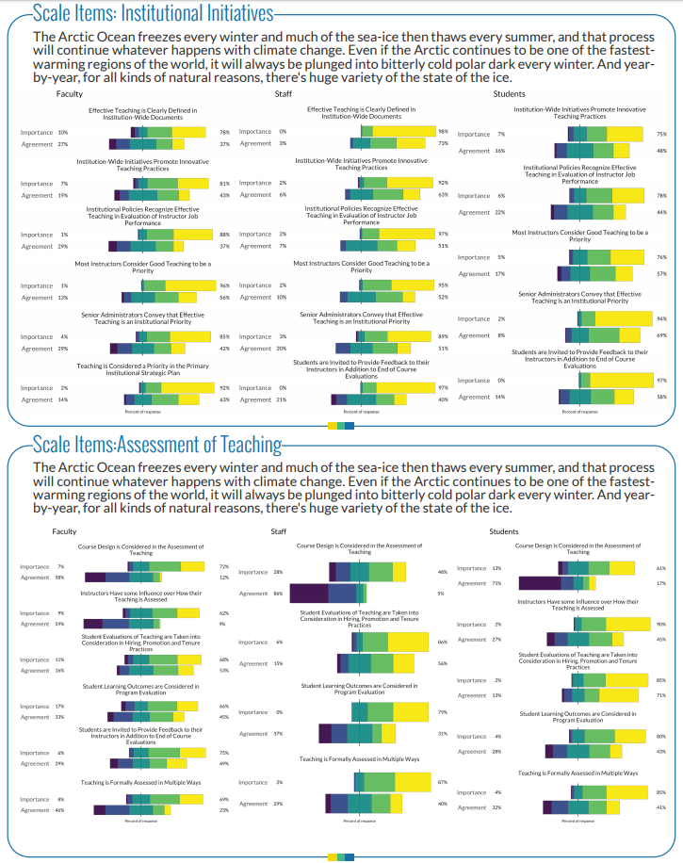
Results Visualization

Slide 15
Results Visualization
Interpret the overall and segmented results &
posit at least one new understanding that might warrant further investigation

Slide 16
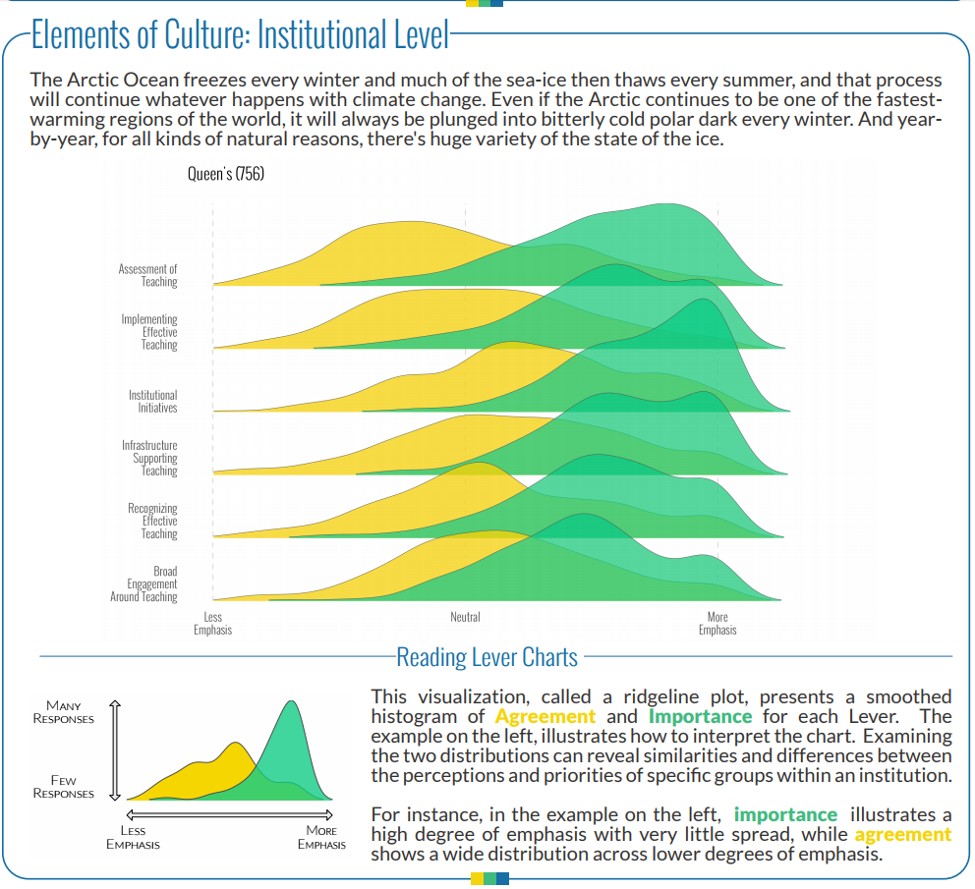
Results Visualization

Slide 17
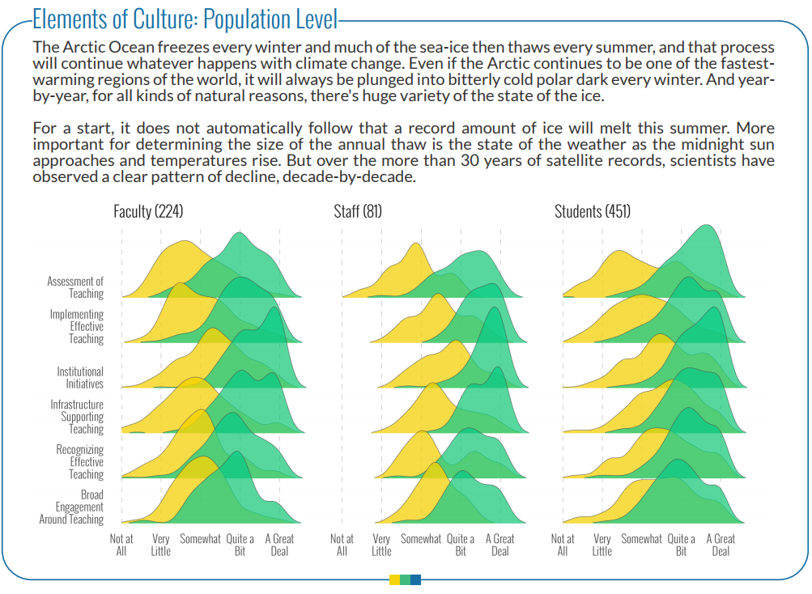
Results Visualization

Slide 18
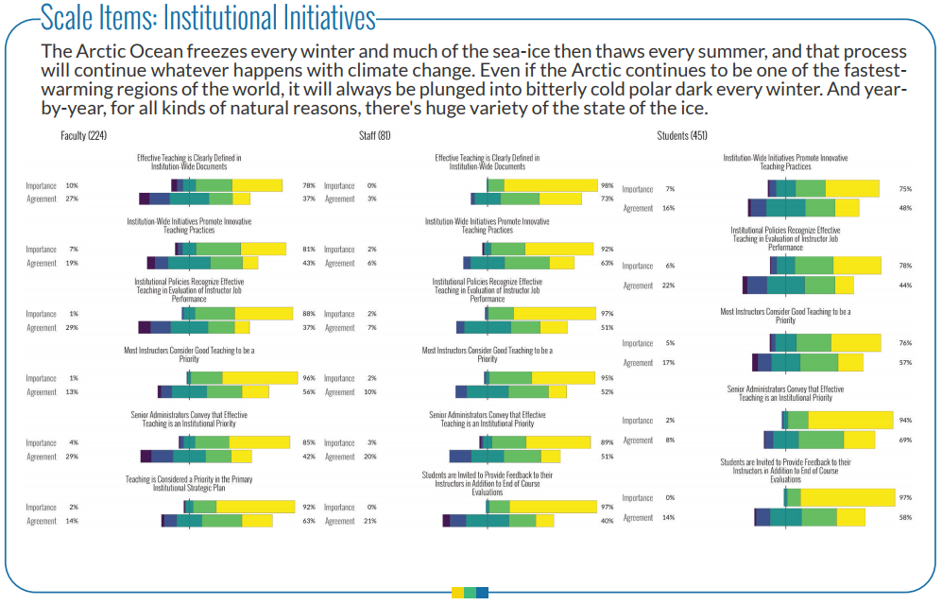
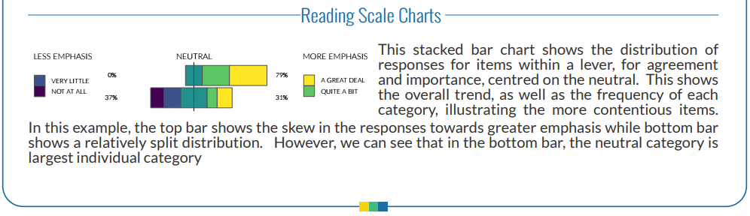
Results Visualization

Slide 19
Results Visualization
What did you like about these visualizations?
Not so much…?
What changes would make the visualizations more informative?
What else do we need to know?

Slide 20
Contact:
Peter Wolf (peter.allan.wolf@gmail.com)
Donna Ellis (donnae@uwaterloo.ca)
Erika Kustra (kustraed@uwindsor.ca)
October 26, 2017

