Slide 1

Part- and Full-Time Faculty Members’ Perceptions of Institutional
Teaching Culture
Debra Dawson, Western University,
Ken N. Meadows, Western University
Erika Kustra, University of Windsor
Lori Goff, McMaster University

Slide 2
The Authors / Research Team https://qualityteachingculture.wordpress.com
Western
Debra Dawson
Ken Meadows
Catharine Dishke Hondzel
University of Windsor
Erika Kustra
Florida Doci, Lindsay Shaw
Hoda Eiliat, Kaitlyn Gillard
McMaster University
Lori Goff
Danielle Gabay
Ryerson University
Paola Borin
Queen’s University
Peter Wolf
University of Waterloo
Donna Ellis
Brock University
Jill Grose
Wilfrid Laurier Univerity
Joe Beer
University of Calgary
Lynn Taylor

Slide 3
Session Overview
Background literature
  What is a quality teaching culture
  Part time and full time faculty
General purpose of the research project
Research hypotheses
Results
Implications of findings & Suggestions for future research

Slide 4


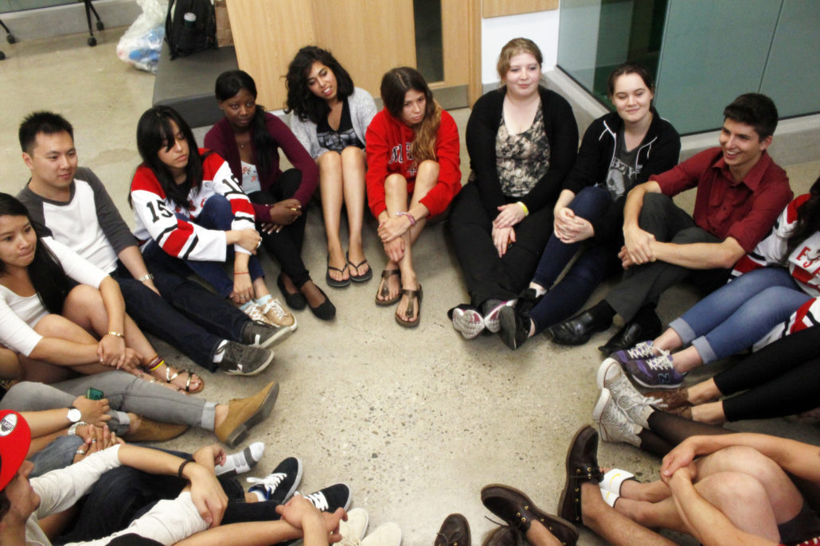
What is a teaching culture?

Slide 5
What is a Teaching Culture?
Institutional culture: embedded patterns, behaviours, shared values, beliefs, and ideologies which help define educator and learner experiences, and can have numerous micro-cultures
(Cox et al., 2011; Kustra et al. 2014; Mårtensson & Roxå, 2016)
Teaching culture: an institutional culture demonstrating teaching is valued (Kustra et al, 2014)

Slide 6
Why does a Teaching Culture Matter?
Contributes to a shared campus commitment to teaching excellence and quality teaching
Impacts student learning, student engagement, and student retention
Influences faculty motivation and behavior
Impacts finances
Berger & Braxton, 1998; Bergquist & Pawlak, 2008;
Cox et al., 2011; Feldman & Paulsen, 1999; Grayson & Grayson, 2003

Slide 7

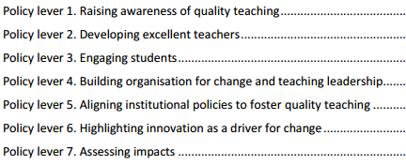
Teaching Culture – Initial Elements
Teaching is recognized in strategic initiatives and practices
Assessment of teaching is constructive and flexible
Faculty are encouraged to develop as teachers
Infrastructure exists to support teaching
Broad engagement around teaching occurs
http://www.oecd.org/edu/imhe/QT%20policies%20and%20practices.pdf

Slide 8
Part time versus Full time faculty
Recent rise in Ontario and throughout the country of the use of part time faculty as instructors in many universities
Suggestion that up to 40% of courses now being taught by part time faculty Canada wide
These PT faculty typically have less support and less engagement with the institution and may work at several institutions concurrently
Often work in relative isolation (Webb, Wong, & Hubball, 2013)

Slide 9
Ryan et al. (2011)—study of PT vs FT faculty
  found no difference in the quality of instruction between the two groups and evidence of good teaching practice—no difference in terms of SETs
  PT faculty were most satisfied about the relationships they had with students and the stimulation of the work itself (internal factors)
  PT faculty were least satisfied with opportunities for promotion, job security, feedback and recognition (external factors)
  Employment conditions are among the factors that negatively impact PT faculty-such as late notice of teaching allocations , underpayment for prep work

Slide 10


Purpose
10
9
7
10
9
Purpose

Slide 11
Survey
The Teaching Culture Perceptions Survey (TCPS) aims to assess faculty members ‘ perceptions of the various components that comprise a teaching culture
TCPS was piloted at 3 Ontario Universities
Work has also been done to identify general indicators that an institution values teaching

Slide 12
Hypotheses of the current study
Sessional faculty will show less agreement with the indicators of teaching quality than tenure & tenure track
Sessional faculty will place more importance on teaching quality than their tenure and tenure track colleagues

Slide 13
Method
Participants:
693 faculty from McMaster, Western, and Windsor
  46% women
  34% Arts and Social Science
  71% 10+ year of teaching experience
  352 Tenured
  64 Tenure track
  160 Sessional

Slide 14
Method
Measure: Teaching Culture Perception Survey – Faculty version (TCPS; Kustra et al., 2014)
  39-item questionnaire
Rate each item twice
  Agreement: Strong Disagree (1) to Strongly Agree (5);
  Importance: Not at all Important (1) to Very Important (5).

Slide 15
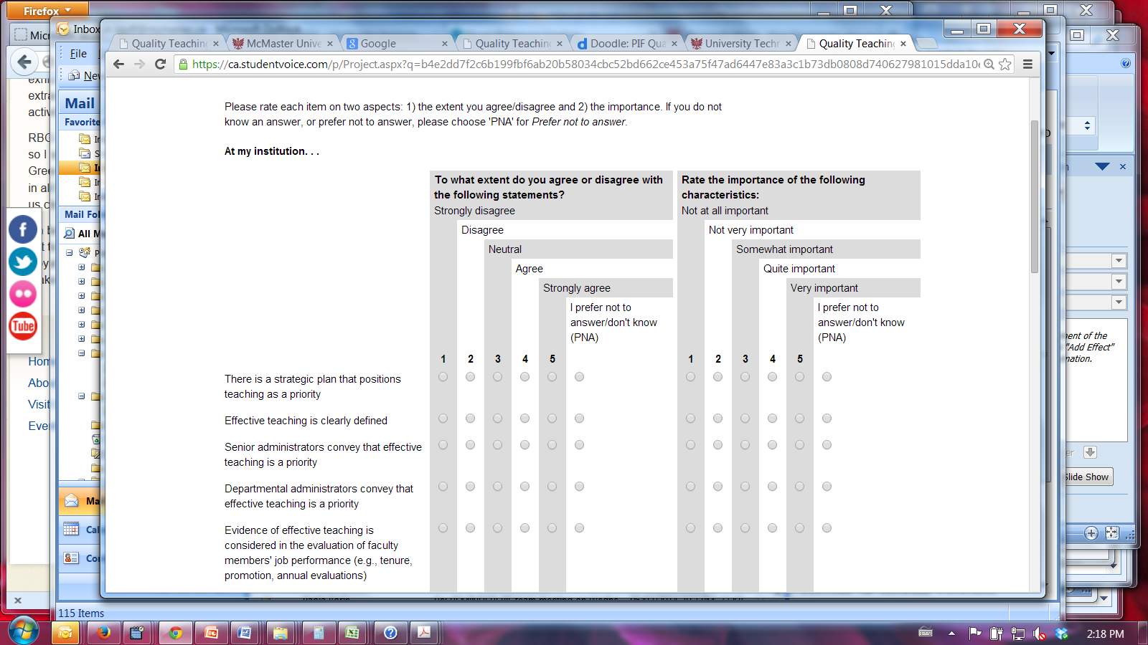
Teaching Culture Perception Survey (TCPS)

Slide 16
Initial Survey Data Analysis
Four Agreement Subscales
Encouraging Effective Teaching
Broad Involvement around Teaching
Recognizing Effective Teaching
Assessing Teaching
Three Importance Subscales
Encouraging Effective Teaching
Recognizing Effective Teaching
Assessing Teaching

Slide 17
Results
Agreement – Recognizing effective teaching

Slide 18
Results
Importance

Slide 19
Summary of results
PT or sessional faculty do not feel that effective teaching is recognized compared to FT faculty
Both PT and tenure-track faculty rated the importance of encouraging, recognizing and assessing effective teaching more highly than tenured faculty

Slide 20
Implications of findings
To increase sessional engagement and sense of belonging things need to change such as increased funding, permanent teaching positions and improved programming for PT or sessional faculty
Webb, Wong & Hubball (2013) suggest that PT faculty could have strengths in professional programs if they were offered supports to integrate them into the university such as a flexible community of practice and a focus on scholarly approach to teaching and learning

Slide 21
Implications of Findings
Jones (2013) found that tenured faculty are the primary institutional decision-makers
As FT tenured faculty members rate the importance of encouraging, recognizing and assessing effective teaching significantly lower than other faculty they may be less likely to allocate resources to these areas
Field and Jones(2016) found that sessional faculty at 12 ON universities wanted additional resources provided to them through their teaching and learning centres-this would require additional resources in a time of scarcity

Slide 22
Future research
Follow up on the type of status of part time faculty and the impact of that on importance of effective teaching
As the cohort of PT faculty grows a longitudinal study may show
  less PT faculty engagement with students
  the impact on teaching quality may be greater
  teaching culture may be more effected
May be discipline specific differences in teaching culture

Slide 23
Future Research
Investigate how to change the culture at universities to foster a focus on teaching in a time where the focus on research is growing (Cox et al., 2011)

Slide 24

Reflection
What might this mean for your institution?
What questions do you have?

Slide 25
References
Denison, D. R. (1996). What is the difference between organizational culture and organizational climate? A native’s point of view on a decade of paradigm wars. Academy of Management Review, 21(3), 619 – 54.
Field, C. C. & Jones, G.A. (2016). A Survey of Sessional Faculty in Ontario Publicly-Funded Universities. Toronto: Centre for the Study of Canadian and International Higher Education, OISE-University of Toronto
Hénard, F. & Roseveare, D. (2012). Fostering quality teaching in higher education: Policies and practices. France: Organization for Economic Co-operation and Development.
Jones, Glen A (2013) The horizontal and vertical fragmentation of academic work and the challenge for academic governance and leadership. Asia Pacific Education Review, 14 (1), 75-83.
Kustra, Erika; Meadows, Ken N.; Dawson, Debra; Hondzel, Catharine Dishke; Goff, Lori; Wolf, Peter; Ellis, Donna; Grose, Jill; Borin, Paola; and Hughes, Sandy E., (2014).Teaching Culture Indicators: Enhancing Quality Teaching. Centre for Teaching and Learning Reports. http://scholar.uwindsor.ca/ctlreports/5
MacDonald, M. (2013). Sessionals up close. University Affairs,54(2), 20-19. Retrieved from http://www.universityaffairs.ca/features/feature-article/sessionals-up-close/

Slide 26


Thank you!
Debra Dawson (dldawson@uwo.ca)
Ken N. Meadows (kmeadow2@uwo.ca)
Erika Kustra (kustraed@uwindsor.ca)
Lori Goff (lgoff@mcmaster.ca)

Slide 27
This research was supported by the Social Sciences and Humanities Research Council of Canada (SSHRC) and the Productivity Innovation Fund (PIF), Ontario Ministry of Training, Colleges and Universities.

